Slide 1
Malnutrition
Course- Advanced Database management system (DAMG 7275)
Team 11 group members:
Amey Parange (002791448)
Yashraj Rajput (002713988)
Abhishek Patil (002713962)
Mayuri Bashirabadkar (002745804)

Slide 2

Problem Statement
Malnutrition is a serious public health problem that affects people in developed as well as developing nations. Malnutrition is a common, under-recognised and under-treated condition in almost every part of world. Tackling this problem by using graphs and charts to visualize.

Slide 3
Objective
To study UNICEF data on malnutrition
Examine the severely afflicted nations that are dealing with the aftereffects of malnutrition, such as obesity, stunting, and underweight
Monitor the nations exhibiting falling and rising trends in terms of malnutrition
Create visualization using Microsoft Power BI

Slide 4
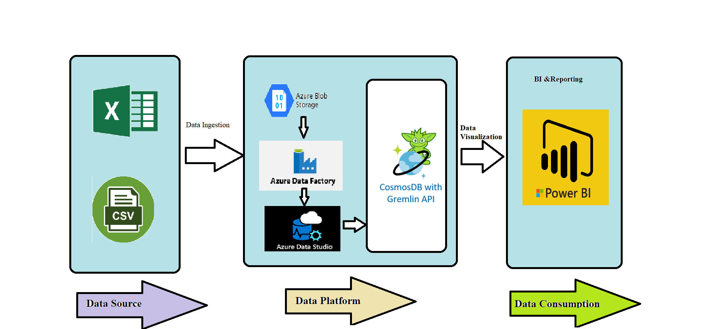
Architecture diagram
Target Platform – Azure
Tools – Power BI for visualization

Slide 5
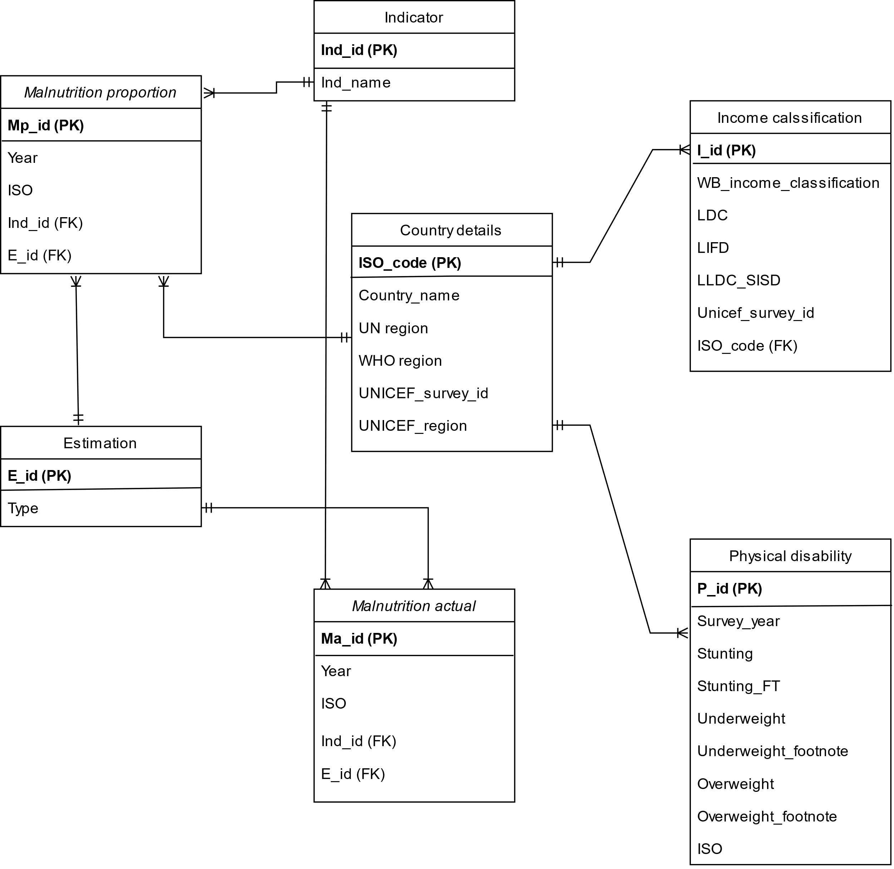
Entity- Relationship Diagram

Slide 6
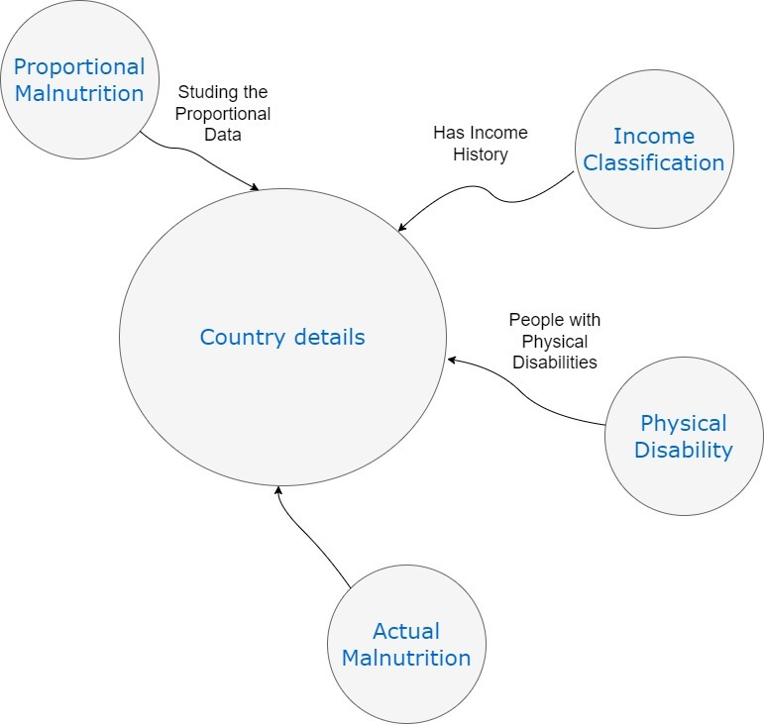
Graph DB Model

Slide 7
Thank You!

